Slide 1
Amazon Fine Food
Review Analysis
DSO599 - Text Analytics & NLP Final Project
Team Members:
Mi Su
Ying Liu
Conglin Xu
Xingjian Zheng
Cristian Quintero

Slide 2
C
onents
1
EDA
2
Sentiment Analysis
3
TF-IDF
4
Prediction Model

Slide 3

Data Description
Variable | Type | Variable | Type
Id | int64 | HelpfulnessDenominator | int64
ProductId | object | Score | int64
UserId | object | Time | int64
ProfileName | object | Summary | object
HelpfulnessNumerator | int64 | Text | object
568,454 Reviews
74,258 Products
Dataset containing reviews of fine foods from Amazon
Source: Kaggle
256,059 Users。

Slide 4
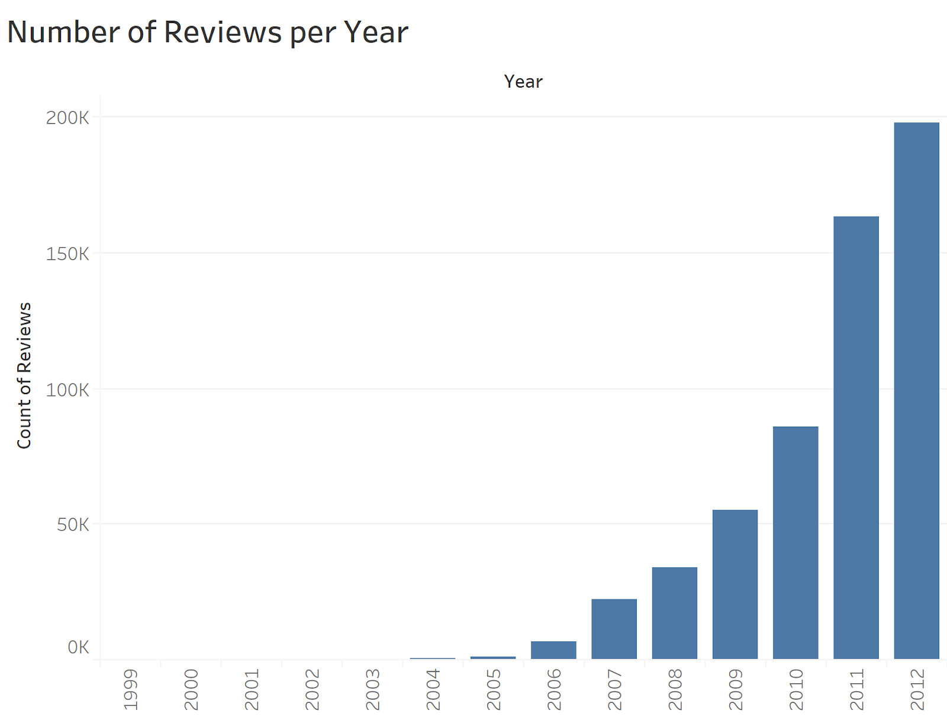
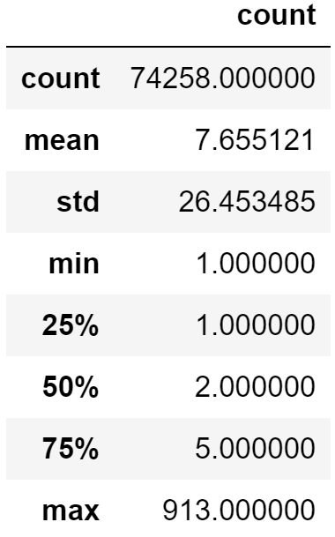
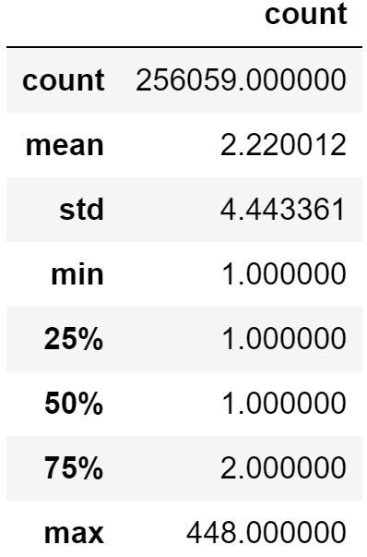
EDA
Reviews per Product
Reviews per
User

Slide 5
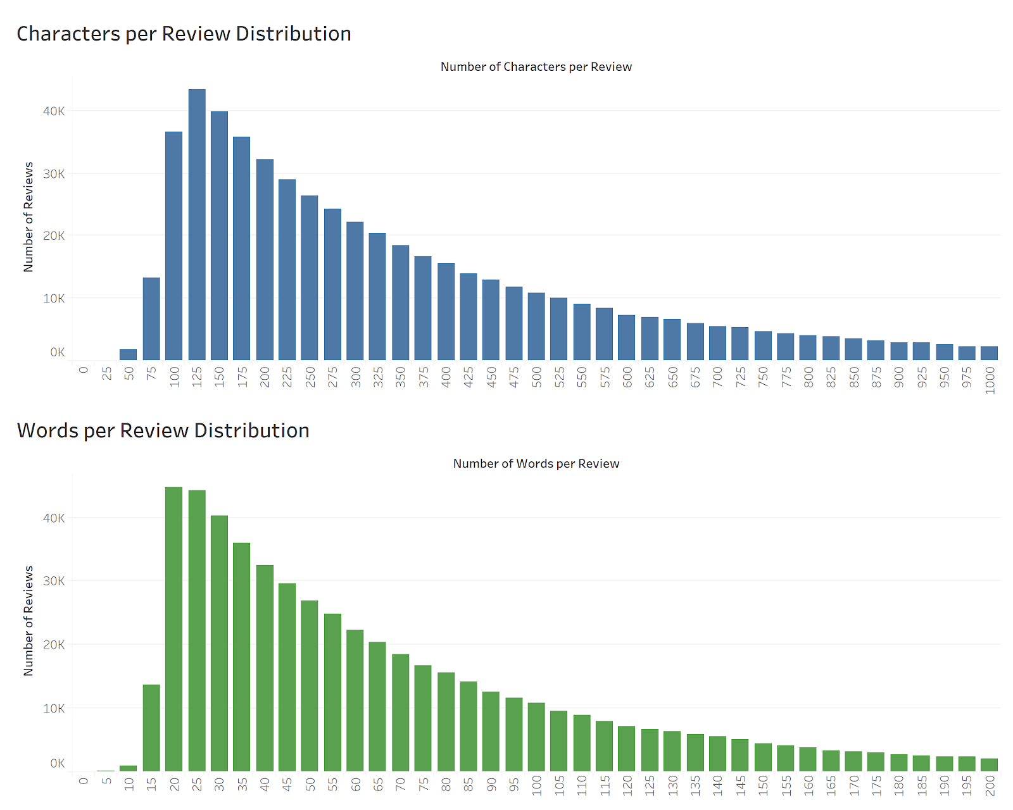
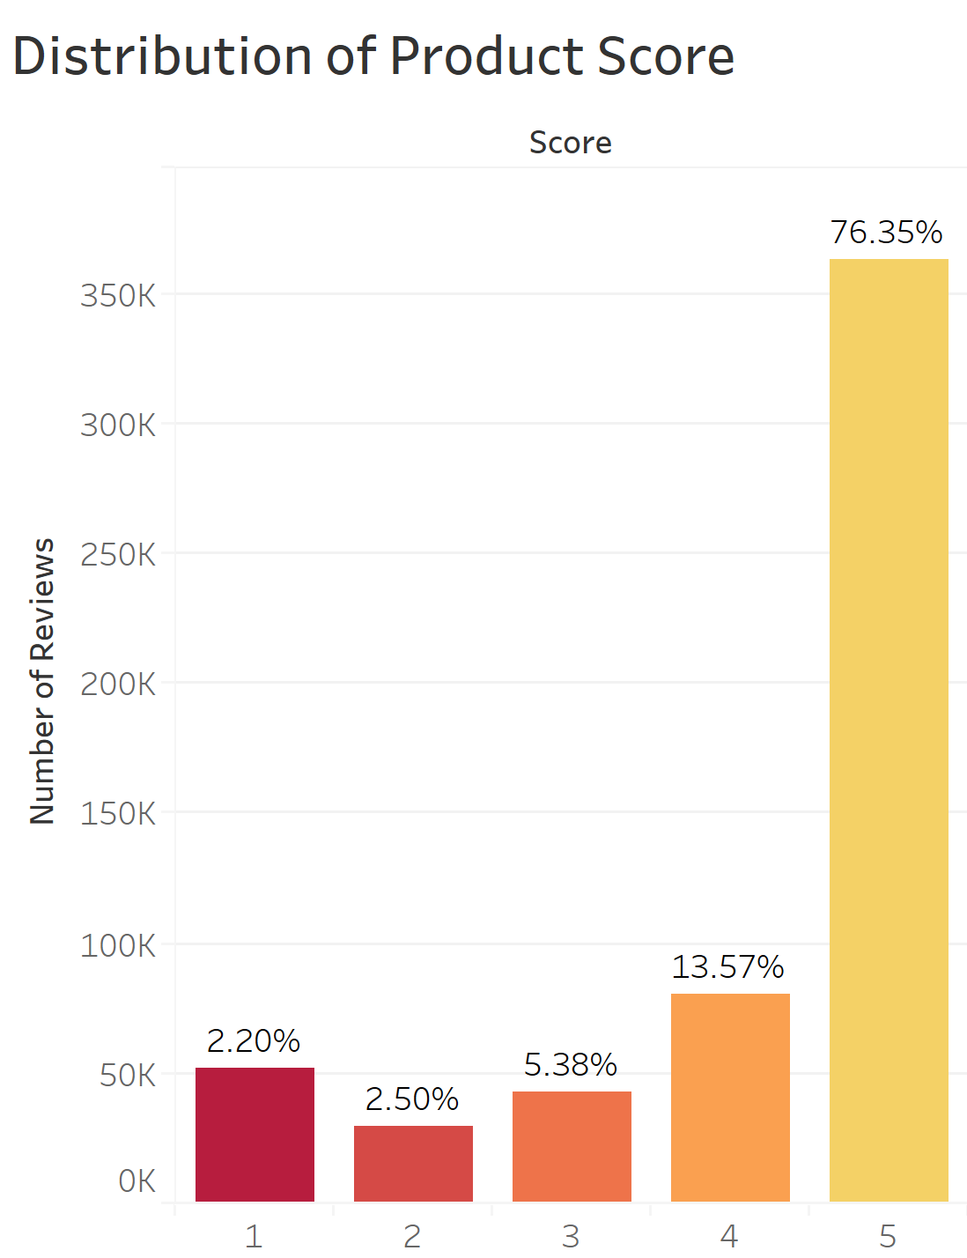
EDA

Slide 6

Business Problems
“Good” and “Bad” Products Identification
Identify “good” and “bad” products based on the sentimental score to optimize the product sales strategy on Amazon website
Products Problem Identification
Identify potential drivers and complaints of products to gain insight about the user experience
Helpfulness Prediction:
Sometimes we want to see not only the most popular/helpful reviews but the most recent reviews. In order to improve the user experience, we aim to build a predictive model to identify the helpful reviews.

Slide 7


‘Good’and ‘Bad’ Products Identification
Business Problem
Methodology & Assumption
Result
Sentimental Analysis
Assumption 1:
Good Product - Top 10 products with the highest sentimental score
Bad Product - Top 10 products with the lowest sentimental score
Assumption 2:
We take the mean value of the sentimental scores for each products as their final sentiment score
Identify what products got highest satisfaction (Good Products) from consumers and what products got bad reviews (Bad Products)
The product_ID for the top 10 best products and the corresponding reviews
The product_ID for the top 10 worst products and the corresponding reviews

Slide 8
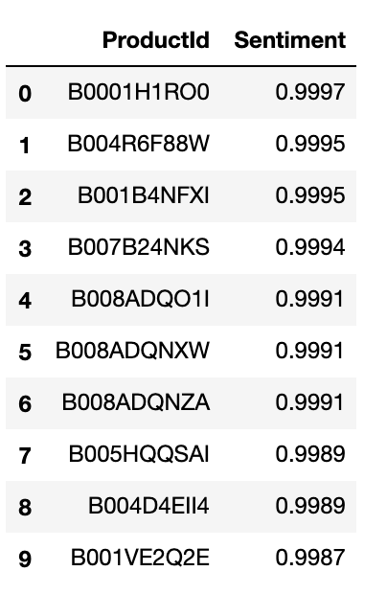
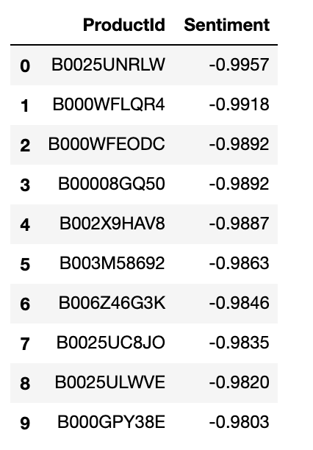
Sentiment Analysis Result
Each day Morinu feeds me like my own nourishing mother, cherishes and consents my whims with this wonderful food...
Since this is individually packaged sweet pickle relish why on earth is FD&C Blue 1 (which is derived from petroleum) included as an ingredient?...
Top 10 Products with highest sentimental score
Top 10 Products with lowest sentimental score

Slide 9
Products Problem Identification
Business Problem
Methodology & Assumption
Result
Identify where the complaints and praises come from and gain insights on the user experience
TF-IDF Word Count
Assumption 1:
High Score - Review score of 4 & 5
Low Score - Review score of 1 - 3
Assumption 2:
we roughly categorized the groups of coffee, tea, cookie, pet foods, and others. E.g. If 50%+ reviews mentions coffee/latte/cappuccino, we would tag it as ‘coffee’
The product category (Coffee, Team, Cookie, Pet foods and Others)
Sorted phrases with tf-idf score

Slide 10
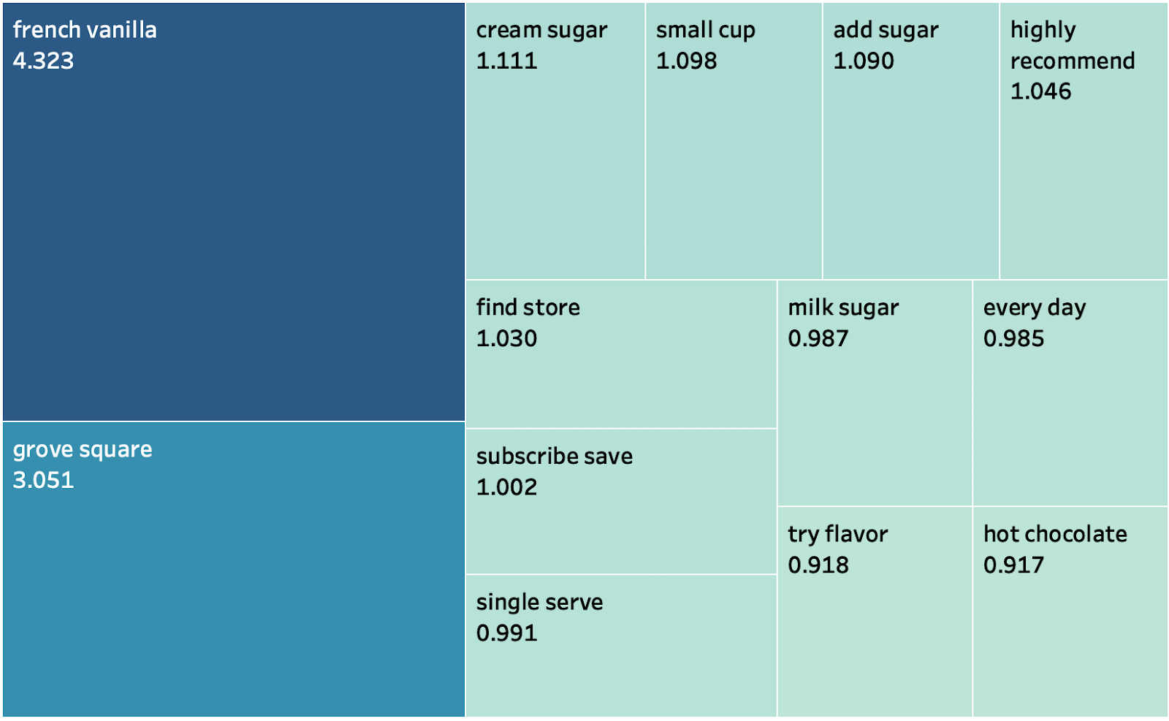
TFIDF Result
Example:
One product of coffee with positive reviews

Slide 11
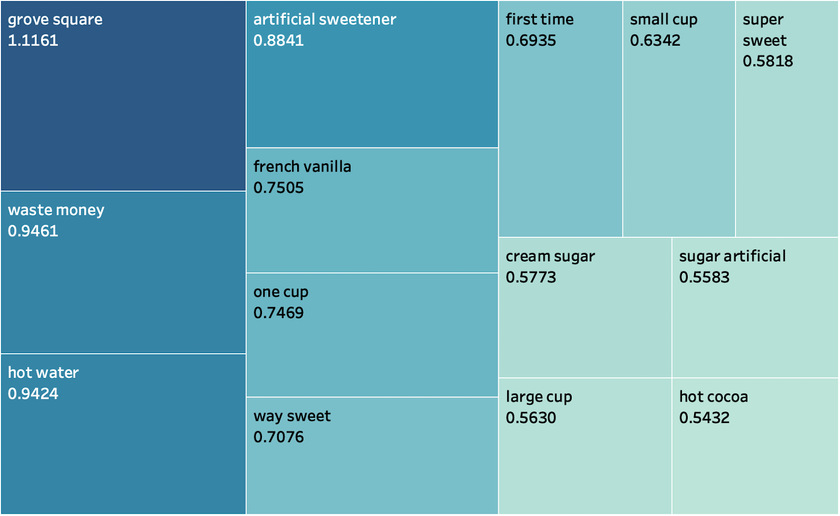
TFIDF Result
Example:
Negative Reviews

Slide 12

Recommendation
The largest complaints come from the sweetness. Provide more options on the sweetness or provide sugar separately to meet different taste
Promote the product by subscription save on Amazon
Further application:
The function could be used to every single product.
Also, we could define a group of similar products (same product with different size) to see the common words from reviews.

Slide 13
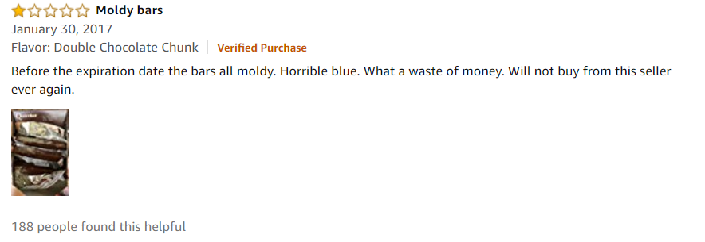
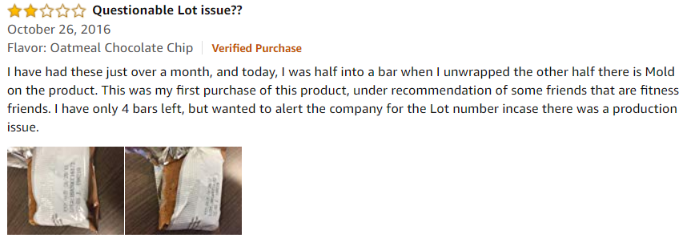
Helpfulness Prediction - Business Problem Statement
Sometimes we want to see not only the most popular/helpful reviews but the most recent reviews
The product might be updated or review fraud.
In order to improve the user experience, we aim to build a predictive model to identify the helpful reviews.

Slide 14
Helpfulness Prediction
Define Helpfulness:
1. Helpful ratio: Helpfulness Numerator/Helpfulness Denominator
2. Label:
Helpful ratio > ⅔ for Helpfulness Denominator < 10
Helpful ratio > ½ for Helpfulness Denominator >= 10

Slide 15
Model Comparison
 | XGBoost | Logistic Regression | Random Forest | Decision Tree | KNN
Accuracy | 65% | 81% | 84% | 85% | 78%
AUC | 61% | 61% | 67% | 67% | 65%
Precision | 34% | 90% | 97% | 97% | 54%
Recommendation:
Instead of only post most popular/helpful reviews, create a hyperlink that leads to the most recent reviews which are identified as helpful by the model

Slide 16
Q & A

